Slide 1
Sodium Bisulfite Methods for Genome Wide Methylation Methods
MALDI-TOF
Bisulfite sequencing
Golden Gate
Pyrosequencing

Slide 2
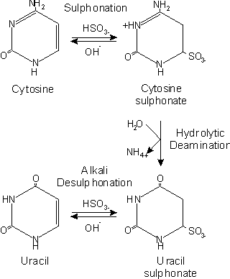
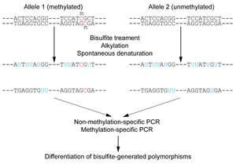
The basic principle is the fact that sodium bisulfite deaminates non-methylated cytosines to uracil while 5-methylcitosines are resistant.
Tollefsbol 2011

Slide 3
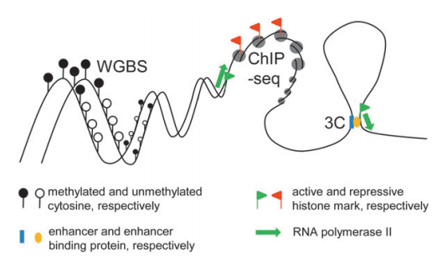
Bisulfite sequencing can be targeted or genome-wide
CpGs
CpGs
MS
Targeted
-Reduced Representation Bisulfite Sequencing (RRBS)
(uses restrictions enzymes MspI: 5’CCGG3’)
-Molecular Inversion Probes (MIP)
(Padlock Probes)
Genome-wide: This is most important standard to examine a tissue- or cell type-speciﬁc methylome
Some studies covered 22% of the CpG sites in chromosome 20 and 22 in 12 human tissues
Weichenhan and Plass, 2013

Slide 4
Targeted Bisulfite Sequencing
Padlock capture
This method simultaneously captures and amplifies large numbers of regions of interest from genomic DNA.
Each padlock probe contains two complementary sequences that hybridize a region of interest. The motifs are linked by a loop of DNA that guarantees efficient hybridization and has universal motifs for PCR universal primers.
Combined with NGS, it has been able to achieve 90–99% of target specificity in mammalian methylomes.
Laird 2010

Slide 5
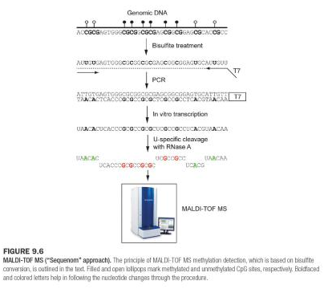
Other bisulfite based methods are:
MALDI-TOF: Matrix-assisted laser desorption/ionization-Time-of-flight mass spectrometry
Tollefsbol 2011

Slide 6
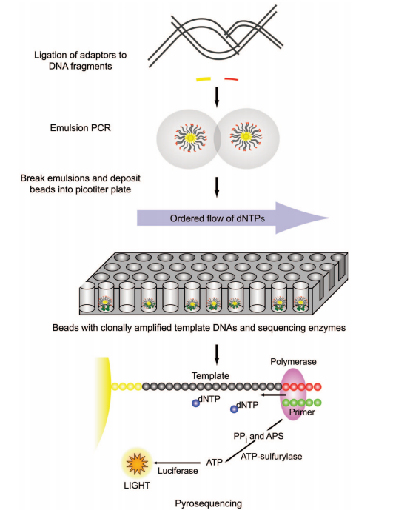
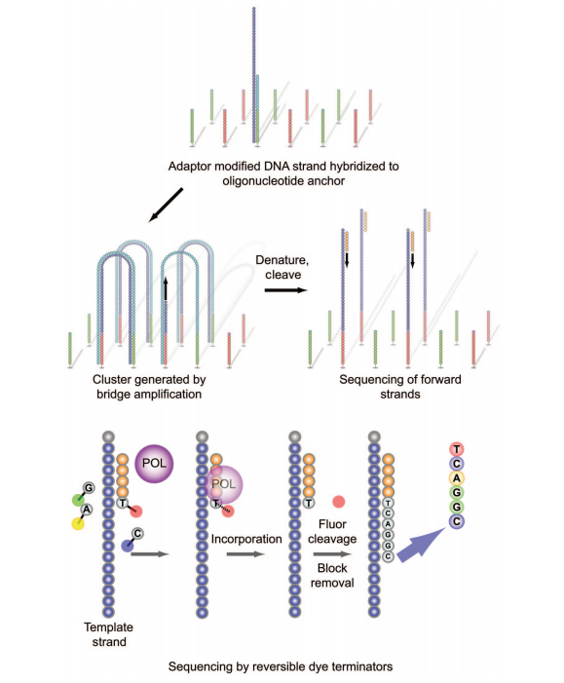
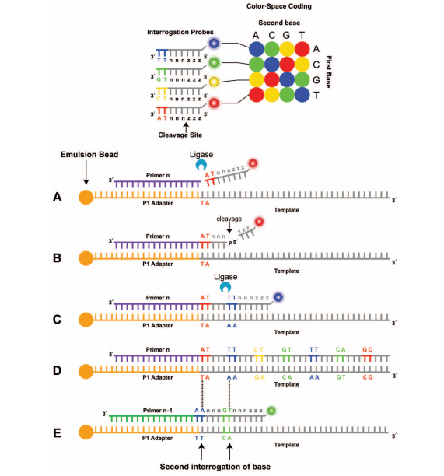
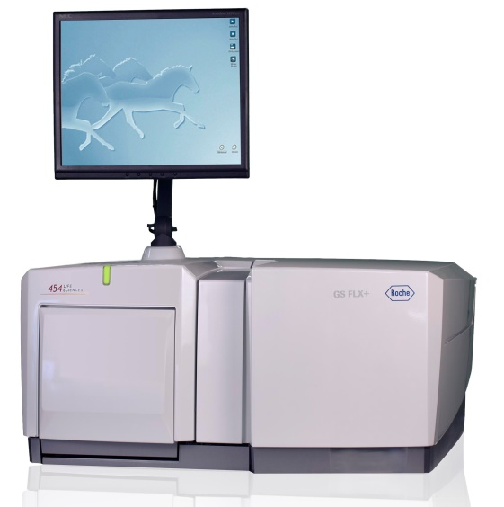
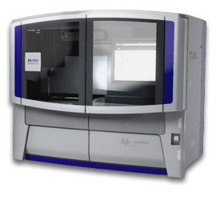
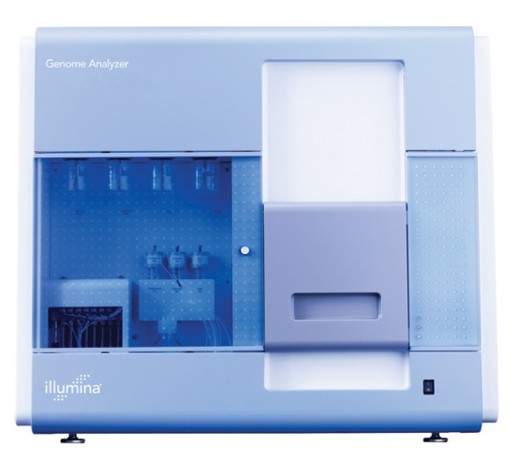
Voelkerding et al 2009
Genome-wide approaches
Next gene sequencing platforms
Roche 454
ABI/SOLiD
Illumina/Solexa

Slide 7
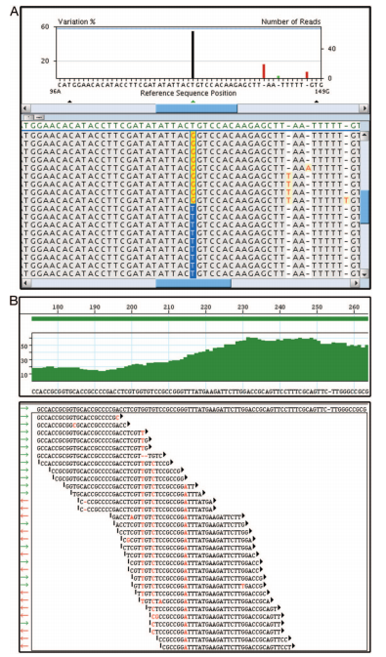
NGS isn’t perfect. It’s cheap and reliable but can be computationally expensive.
Voelkerding et al 2009

Slide 8
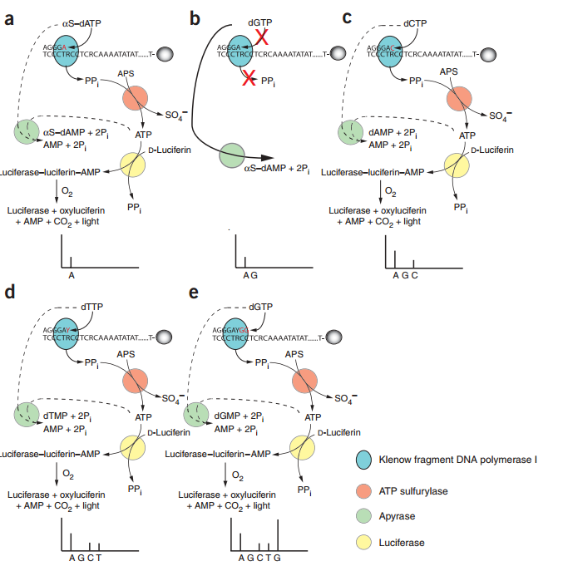
Pyrosequencing
Sequencing by synthesis, this system detects pyrophosphates by luminotropic detection when they are released upon nucleotide incorporation.
Tost and Gut, 2007

Slide 9
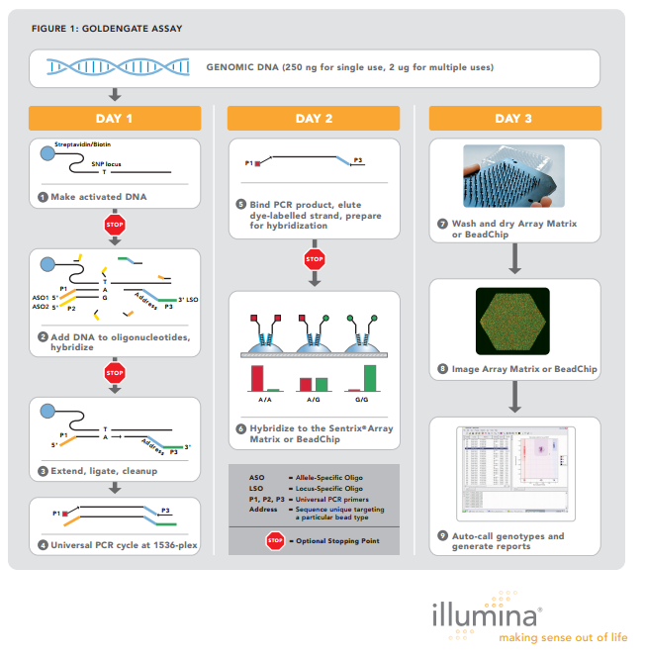
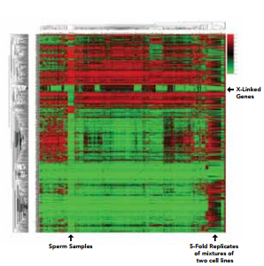
Illumina GoldenGate (and Infinium assay)
Is an Array-based method which is excellent for characterizing and analyzing large numbers of samples
Illumina Inc, 2010

Slide 10
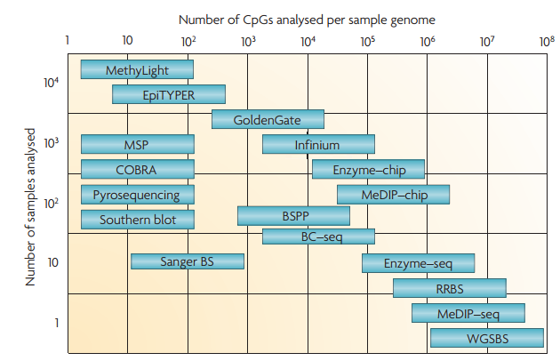
Plot of sample size vs genome coverage for a diverse set of DNA methylation techniques
Laird 2010

Slide 11
Biological Affinity-Based Methods of DNA Methylation Detecton: Genome Wide
MeDIP, MAP and MIRA

Slide 12
The Basic Idea
Some antibodies have a high affinity for methylated DNA, or methylation-specific proteins, which means that they will bind to methylated sites on DNA, but not to non-methylated sites
DNA is sheared via sonication (aka, ultra-sound vibration), purified, and treated with those antibodies
This follows the same basic methodology as on the gene-specific scale, but use of micro-arrays and parallel sequencing gives a genome-wide result

Slide 13
MeDIP
Acronym, stands for Methylated DNA Immunoprecipitation
Genomic DNA is extracted, sonicated, denatured, incubated with monoclonal 5mC antibodies, which bind to the methylated cytosines, and is classically immunoprecipitated: bound DNA is separated from unbound DNA, and from here, several different methods can be used to quantify ‘enrichment’

Slide 14
MeDIP (cont.)
One way to quantify enrichment is by comparison to the original genome, using a high density microarray –Basically, some of the original genomic material is labeled with red cytosines while the enriched DNA is labeled with green cytosines, which make for a visible comparison
Another is to run the enriched DNA through a high-throughput sequencer and compare it to the original DNA

Slide 15
How to MeDIP
Notes:
MeDIP. N.d. Photograph. WikipediaWeb. 29 Jan 2014. <http://en.wikipedia.org/wiki/File:Medip-final-2.jpg>.

Slide 16
MAP
Surprisingly, another acronym. Stands for MBD Affinity Purification
This method uses Methyl CpG binding Proteins, variable called MBDs, MeCPs, etc., which binds to methylated CpGs and not DNA
Basically the same method as MeDIP but without immunoprecipitation or high-throughput sequencing comparisons
Comparison is conducted by analyzing percentage of methylated-unmethylated DNA

Slide 17
How to MAP
Notes:
Lan, Xun. Overview of experimental design and analysis. N.d. Photograph. www.plosone.orgWeb. 29 Jan 2014. <http://www.plosone.org/article/info:doi/10.1371/journal.pone.0022226>.

Slide 18
MIRA
One last acronym, stands for Methylated CpG Island Recovery Assay
Uses a hybrid MBD protein (MBD2b and MBD3L1) to bind to methylated sites on DNA
Same basic method as MeDIP, only the DNA needn’t be denatured, since the hybrid MBD has a high methyl-affinity
Again, similar to MeDIP, this is conducted on a gene-specific scale as listed, but on a genome-wide scale via micro-array; must use PCR reactions to amplify the tiny amount of DNA used

Slide 19
How to MIRA
Notes:
MethylCollector™ Ultra. N.d. Photograph. http://www.activemotif.com/catalog/43/methylcollector-ultraWeb. 29 Jan 2014.

Slide 20
Pros/Cons
MeDIP – Pros: Fast, cheap, works easily with large scale analysis; Cons: DNA must be single-stranded, must have quality enzymes or risk false-data, method has inherent bias for specific sequences
MAP – Pros: Outdated and thus cheap, works easily and quickly with large scale, relatively easy (computationally); Cons – outdated, needs a large amount of DNA to work with, same inherent bias
MIRA – Pros: Low false-positive rate, sensitive, needs very little material to work with; Cons- Low sensitivity in CpG poor regions, limited by MBD binding ability, which, again, has an inherent bias

Slide 21
Issues with Biological Affinity
Recently, it was discovered that several variants of cytosine exist, one of them, 5-hmC (in contrast to 5-mC) in mammalian cells.
Most techniques, including MeDIP, MIRA and MAP, do not distinguish one from the other, leading to incorrect assessments of overall genomic methylation
Solution: commerical application of PvuRst1, an enzyme capable of making that distinction OR Beta-Glucosyltransferase enzyme, which tags hmC’s with sugar to create a distinction

Slide 22
References
Laird, P. W. (2010). Principles and challenges of genomewide DNA methylation analysis. Nature reviews. Genetics, 11(3), 191–203. doi:10.1038/nrg2732
Tost, J., & Gut, I. G. (2007). DNA methylation analysis by pyrosequencing. Nature protocols, 2(9), 2265–75. doi:10.1038/nprot.2007.314
Voelkerding, K. V, Dames, S. a, & Durtschi, J. D. (2009). Next-generation sequencing: from basic research to diagnostics. Clinical chemistry, 55(4), 641–58. doi:10.1373/clinchem.2008.112789
Weichenhan, D., & Plass, C. (2013). The evolving epigenome. Human molecular genetics, 22(R1), R1–6. doi:10.1093/hmg/ddt348

